Slide 1
Spring Fundamentals
Architecting a Spring Web Service

Slide 2
Separating Concerns into Layers
Onion Architecture

Slide 3
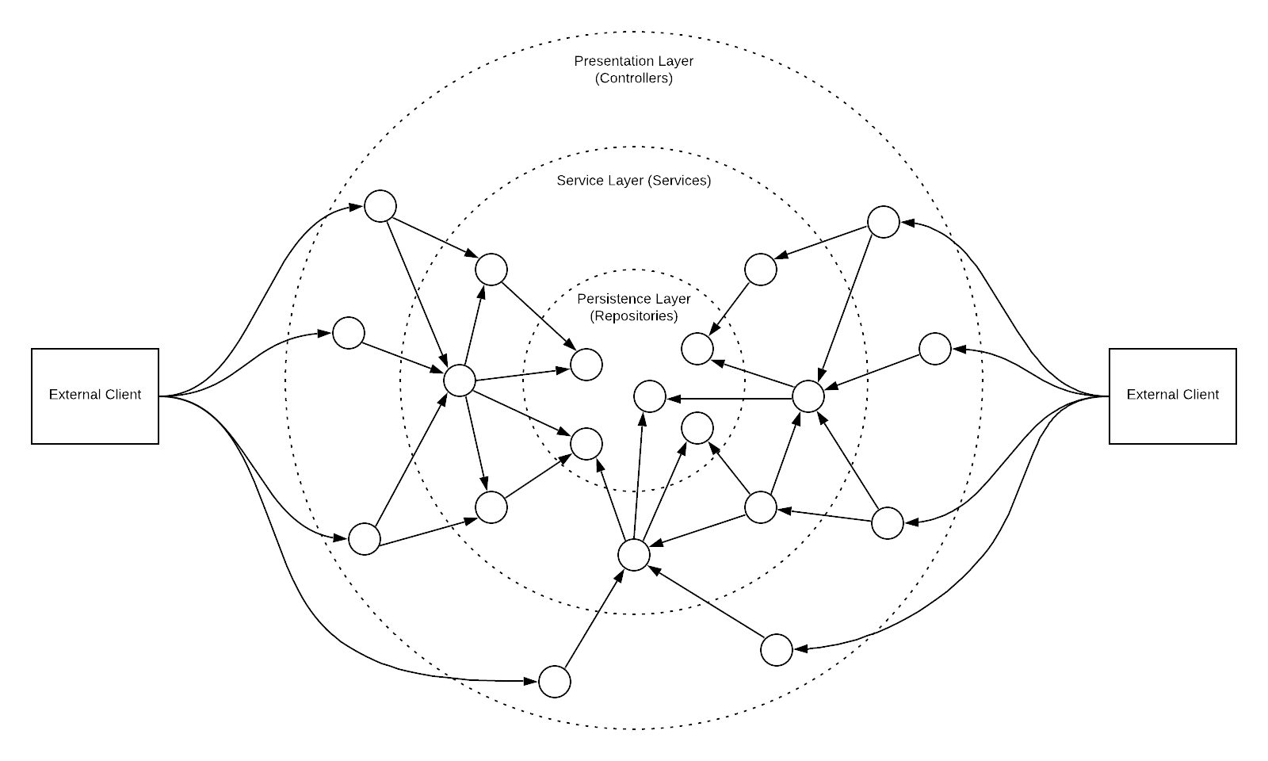
Onion Architecture

Slide 4
Creating our first project

